Slide 1
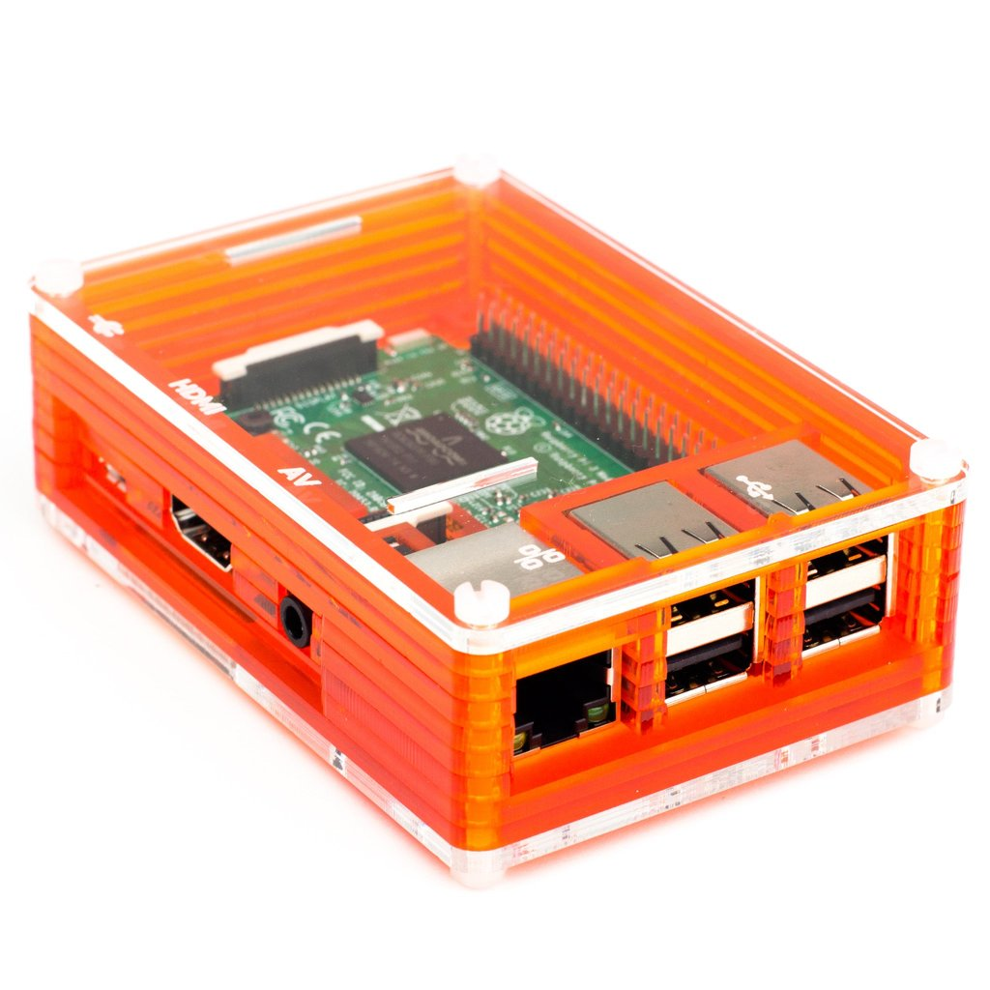
BME 280 Sensor
Samuel Dadet

Slide 2
Proposal
The aim of this project was to allow me read and record the temperature, humidity and altitude of our surroundings . The sensor will be able to give real time data to the user based on how the reading intervals were set. i.e. if you want live readings every 2 secs or 1 sec or 60 secs, You can change that in the code.
This sensor is used in various devices around the world from your smartwatch to Indoor navigation ( elevator and floor change detection), weather forecast etc.

Slide 3
Budget
raspberry pi - $80 SD Card - $20 B.M.E 280 - $45
R-J 45 - $10
Power Supply - $10
Total: $165

Slide 4
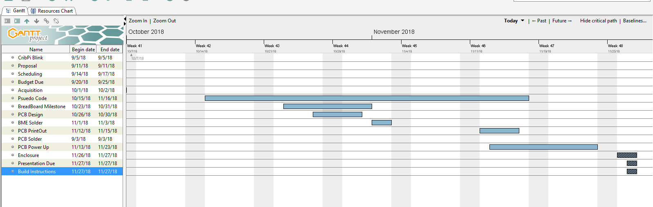
Schedule

Slide 5
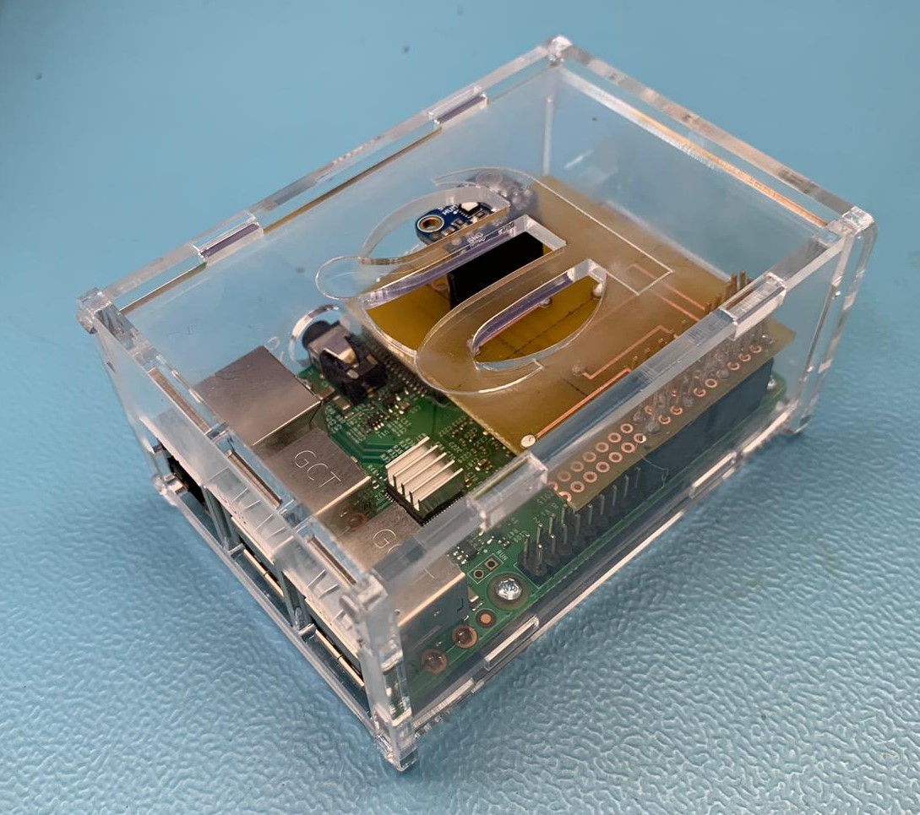
Enclosure

Slide 6
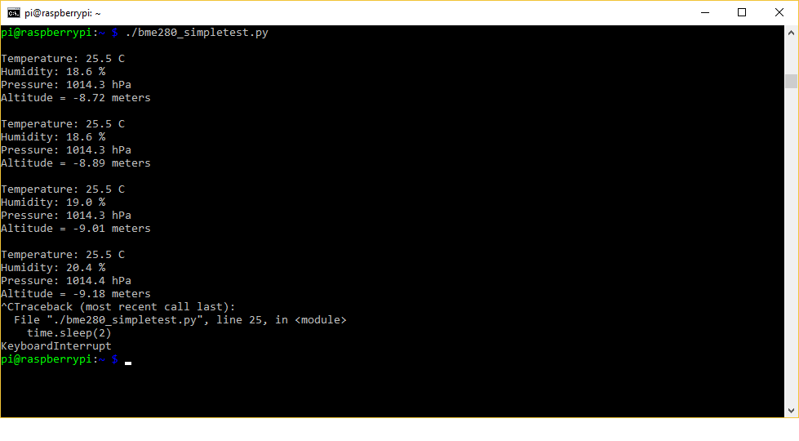
Reading /Writing BME 280

Slide 7
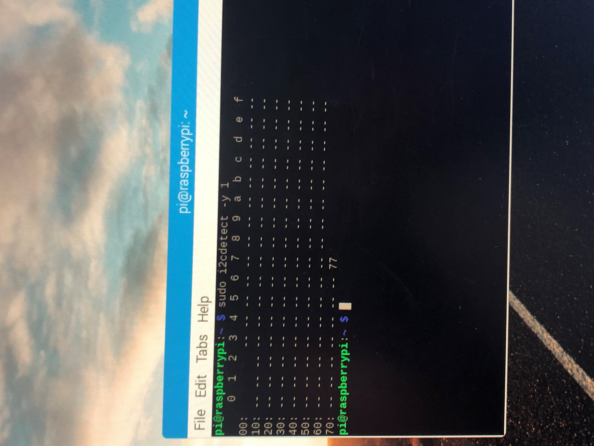
I2C Address

Slide 8
Course Knowledge
CENG 252 – Embedded Systems – we used the bme 280 last semester which helped me tremendously in my project.
CENG 215 – Digital Interface Systems – we played with function generators, Oscilloscopes, resistors and breadboards which was the core course that actually got me through a chunk of the project.
CENG 220 – Writing Skills - it helped me to develop my writing skills for presentations(like this one), formal reports and my blog.

Slide 9


Slide 10

See Y’LL IN COMPUTER SYSTEMS PROJECT

